Slide 1



Linux System Administration [ LSA ]
Linux History
Stoyan Stoyanov Sto
CTO
XS Software JSco
sto@softuni.bg
www.softuni.bg

Slide 2
The Beginning and the GNU
Software Distribution: hand-by-hand, man-to-man, university-to-university
1969– AT&T at BellLabs, create own OS, the First Unix Release, written on assembler
1973 - rewrites on C and widely adopted ,C is written by Ken Thompson and Dennis Ritchie ( from AT&T )
1982 – System III , first commersial UNIX , after that a lot of derivatives are created
1983/1984 – SystemV is released. All of SystemIII derivates are documented and standarted as Unix.
~198{1,2,3} – ‘Richard Stallman’ , system programmer, and the printer story☺
1983 27 September – The GNU Project is Released. Started to be an OS, Stallman creates
GNU: (GNU is not Unix)
GNU: "a sufficient body of free software [...] to get along without any software that is not free."
Links:
http://en.wikipedia.org/wiki/History_of_Linux
http://www.tldp.org/LDP/intro-linux/html/sect_01_01.html

Slide 3
25 August 1991, Linus Benedict Torvalds
1991 – Linux 0.01, starts as a Linus’s personal project, the goal was creating free operating system kernel
  - under GNU
  - Alot of contributors starts using it, make drivers etc.
The NAME: First Linus called the project Freax (free, freak, x from Unix), BUT the FTP administrator renamed it to: Linux, Torvalds says OK ☺
1992 – Linux 0.99, under GNU GPL
Hello everybody out there using minix -
I'm doing a (free) operating system (just a hobby, won't be big and professional like gnu) for 386(486) AT clones……
PS. Yes – it's free of any minix code, and it has a multi-threaded fs. It is NOT portable (uses 386 task switching etc), and it probably never will support anything other than AT-harddisks, as that's all I have :-(.
Links:
http://en.wikipedia.org/wiki/History_of_Linux
http://www.tldp.org/LDP/intro-linux/html/sect_01_01.html

Slide 4
Linux is the linux kernel
Linux – is the linux kernel
Linux Distribution – is a set of tools that form complete OS
POSIX - POSIX is the Portable Operating System standard. It describes certain utilities, APIs, and services a compliant operating system must provide to software. The idea is that a program written for one POSIX-Compliant OS would be easier to port to another POSIX-compliant OS

Slide 5
Linux Distributions: The Three Giants
1992 – Softlanding Linux System (SLS) , spawned to the well-known Slackware – the OLDEST linux distribution
1993 – Debian GNU/Linux
- not a fork of any previous work
- absolutely independent project , community driven
- today: the largest non-commercial linux distribution (according to linux magazine)
1994 – Red Hat Linux
- designed for the corporate world
- was and IS a commercial distribution build upon free software
Links:
http://www.linux-mag.com/id/7721/

Slide 6
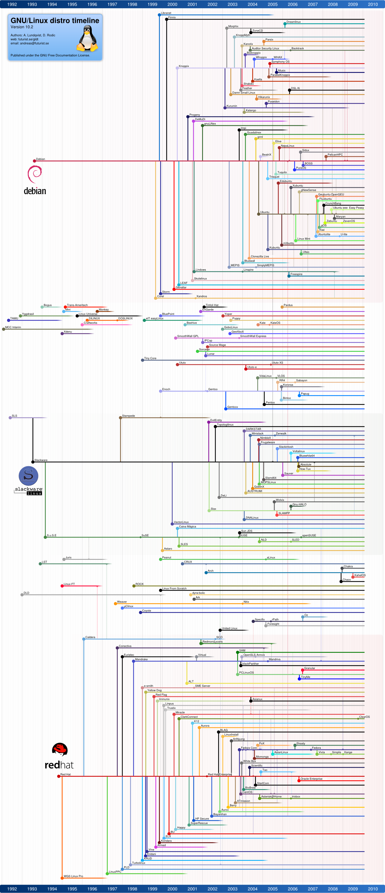
Linux Distributions: The Three Giants
Please Look inside the big picture:
http://www.linux-mag.com/s/i/articles/7721/gldt102-full.png

